Slide 1
FILTERING IN FREQUENCY DOMAIN

Slide 2
Introduction to the Fourier Transform
and the Frequency Domain
The one-dimensional Fourier transform and its inverse
Fourier transform (continuous case)
Inverse Fourier transform:
The two-dimensional Fourier transform and its inverse
Fourier transform (continuous case)
Inverse Fourier transform:

Slide 3
Introduction to the Fourier Transform
and the Frequency Domain
The one-dimensional Fourier transform and its inverse
Fourier transform (discrete case) DTC
Inverse Fourier transform:

Slide 4
Introduction to the Fourier Transform
and the Frequency Domain
Since and the fact
then discrete Fourier transform can be redefined
Frequency (time) domain: the domain (values of u) over which the values of F(u) range; because u determines the frequency of the components of the transform.
Frequency (time) component: each of the M terms of F(u).

Slide 5
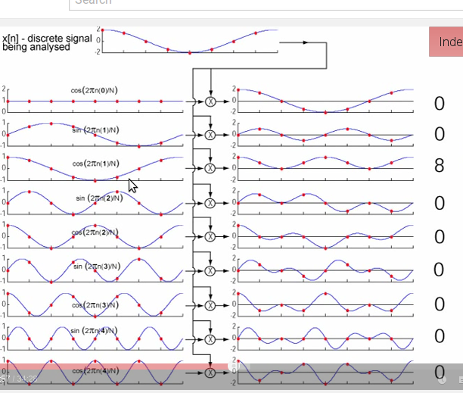

Slide 6
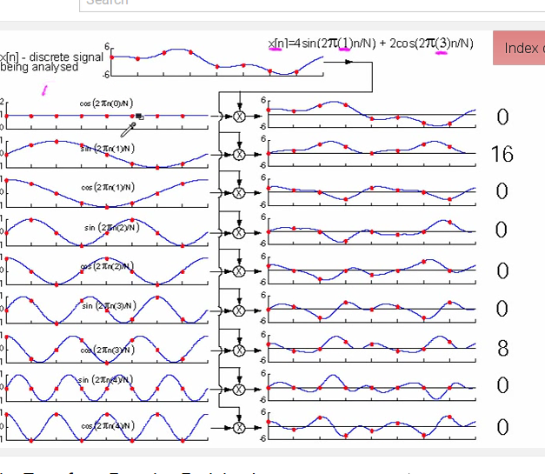

Slide 7
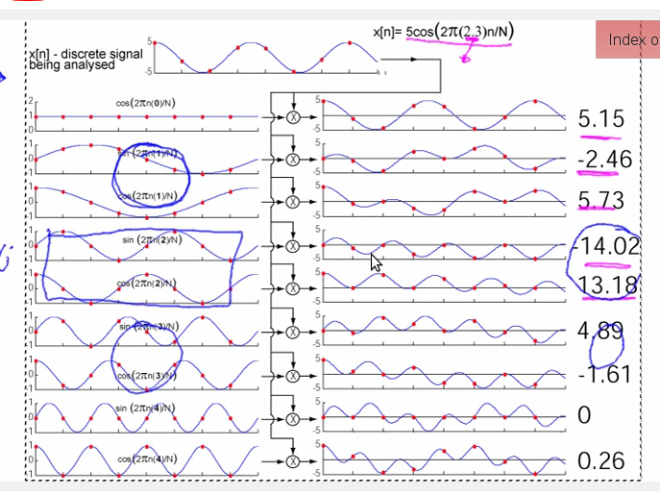

Slide 8
Introduction to the Fourier Transform
and the Frequency Domain
F(u) can be expressed in polar coordinates:
R(u): the real part of F(u)
I(u): the imaginary part of F(u)
Power spectrum:

Slide 9
Introduction to the Fourier Transform
and the Frequency Domain
The two-dimensional Fourier transform and its inverse
Fourier transform (discrete case) DTC
Inverse Fourier transform:
u, v : the transform or frequency variables
x, y : the spatial or image variables

Slide 10
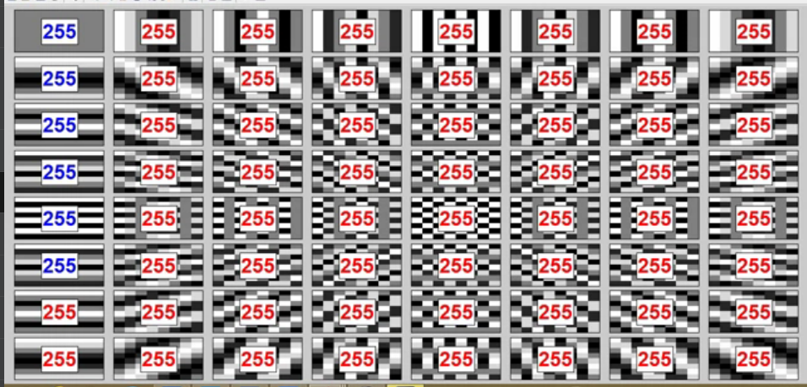

Slide 11
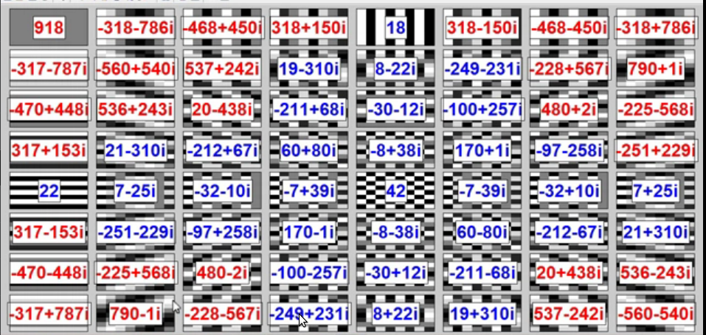

Slide 12
Introduction to the Fourier Transform
and the Frequency Domain
We define the Fourier spectrum, phase anble, and power spectrum as follows:
R(u,v): the real part of F(u,v)
I(u,v): the imaginary part of F(u,v)

Slide 13
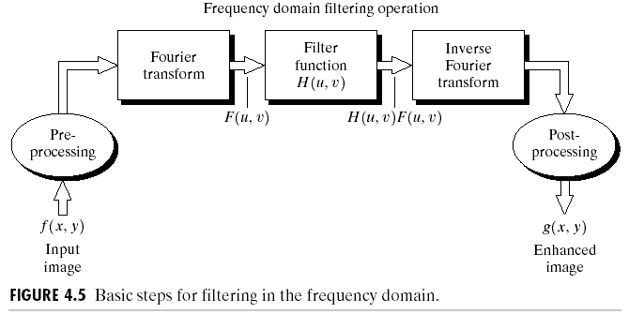
Basics of Filtering in the Frequency Domain
Multiply input
Image by (-1)x+y to
center the transform

Slide 14
Filter- Filter supresses certain frequencies in the transform while leaving others unchanged.
G(u,v)= H(u,v) F(u,v)
Multiplication is on element by element basis.
Zero-phase-shift filter- H contain real components. Each real component of H is multiplied to real and imaginary component of F , this do not change phase of the transform.

Slide 15
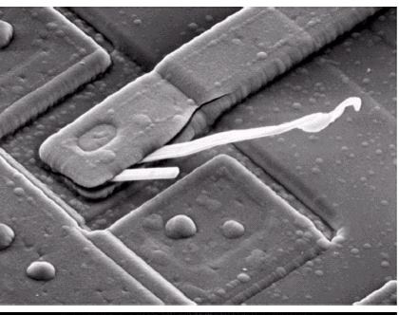
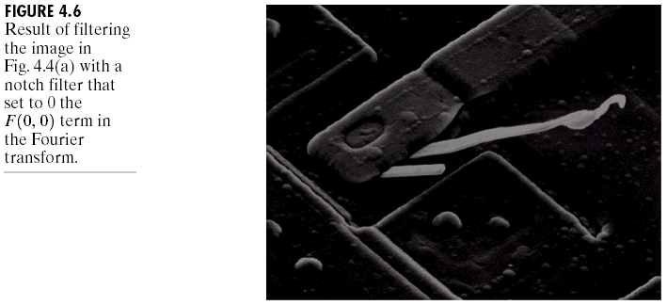
Some Basic Filters and Their Functions
Multiply all values of F(u,v) by the filter function (notch filter):
All this filter would do is set F(0,0) to zero (force the average value of an image to zero) and leave all frequency components of the Fourier transform untouched.

Slide 16
Some Basic Filters and Their Function
Low frequencies in Fourier Transform are responsible for the general gray level appearnce of an image over smooth areas, while high frequency are responsible for details such as edges and noise.
A filter that attenuates high frequencies by passing low frequencies is called low pass filter.Filter that has opposite charaterstics is high pass filter

Slide 17
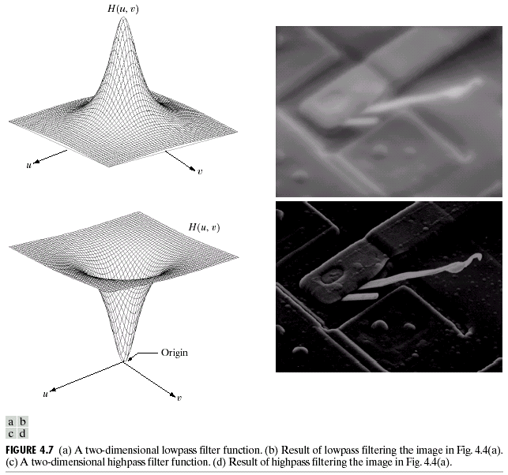
Some Basic Filters and Their Functions
Lowpass filter
Highpass filter

Slide 18
Smoothing Frequency-Domain Filters
The basic model for filtering in the frequency domain
where F(u,v): the Fourier transform of the image to be smoothed
H(u,v): a filter transfer function
Smoothing is fundamentally a lowpass operation in the frequency domain.
There are several standard forms of lowpass filters (LPF).
Ideal lowpass filter
Butterworth lowpass filter
Gaussian lowpass filter

Slide 19
Ideal Lowpass Filters (ILPFs)
The simplest lowpass filter is a filter that “cuts off” all high-frequency components of the Fourier transform that are at a distance greater than a specified distance D0 from the origin of the transform.
The transfer function of an ideal lowpass filter
where D(u,v) : the distance from point (u,v) to the center of the frequency rectangle

Slide 20
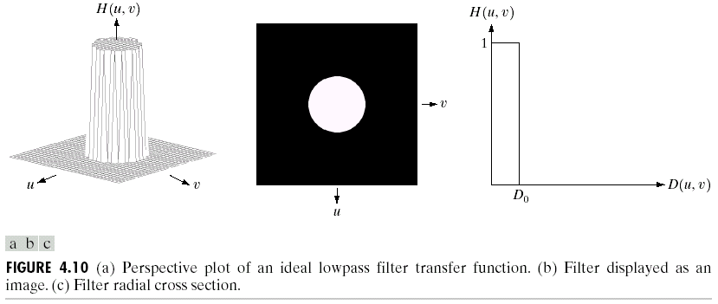
Ideal Lowpass Filters (ILPFs)

Slide 21
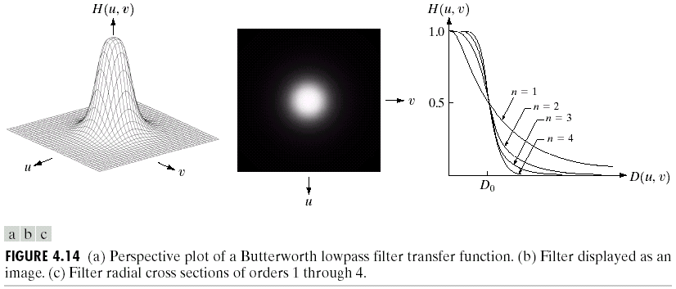
Butterworth Lowpass Filters (BLPFs)
With order n

Slide 22
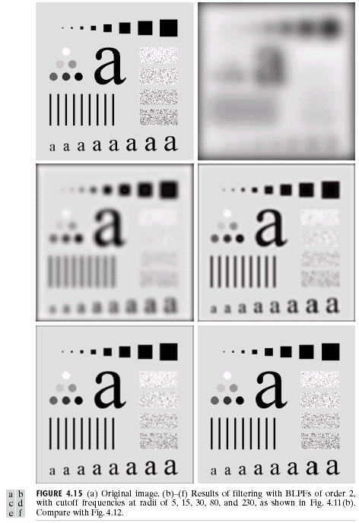
Butterworth Lowpass
Filters (BLPFs)
n=2
D0=5,15,30,80,and 230

Slide 23
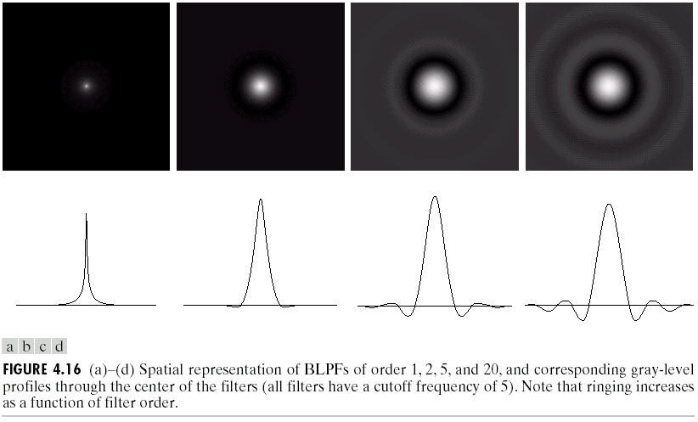
Butterworth Lowpass Filters (BLPFs)
Spatial Representation
n=1
n=2
n=5
n=20

Slide 24
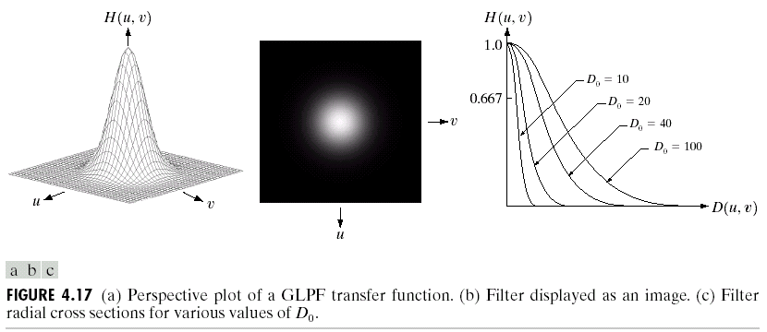
Gaussian Lowpass Filters (FLPFs)

Slide 25
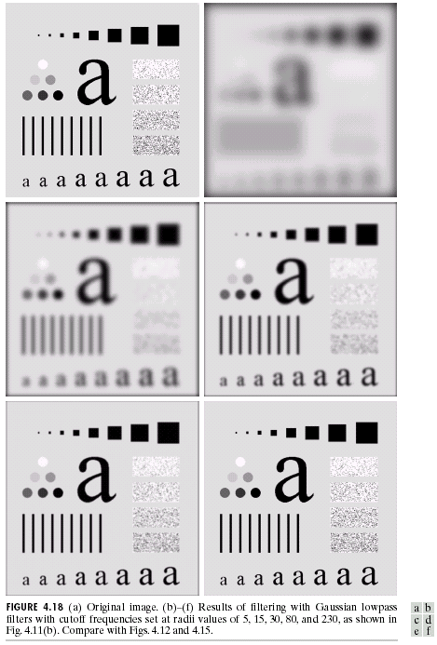
Gaussian Lowpass
Filters (FLPFs)
D0=5,15,30,80,and 230

Slide 26
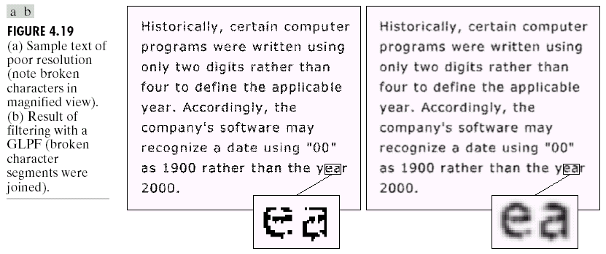
Additional Examples of Lowpass Filtering

Slide 27
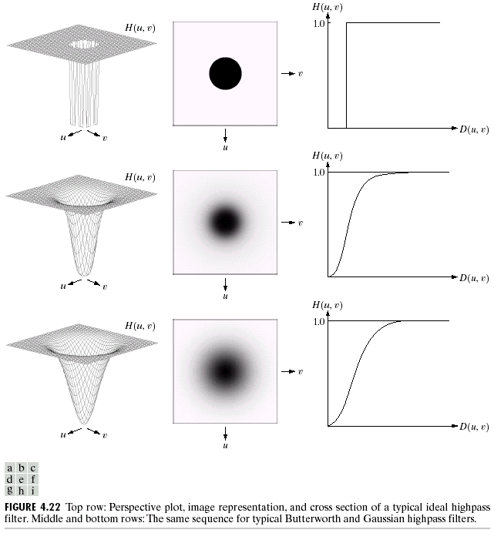
Sharpening Frequency Domain Filter
Ideal highpass filter
Butterworth highpass filter
Gaussian highpass filter

Slide 28
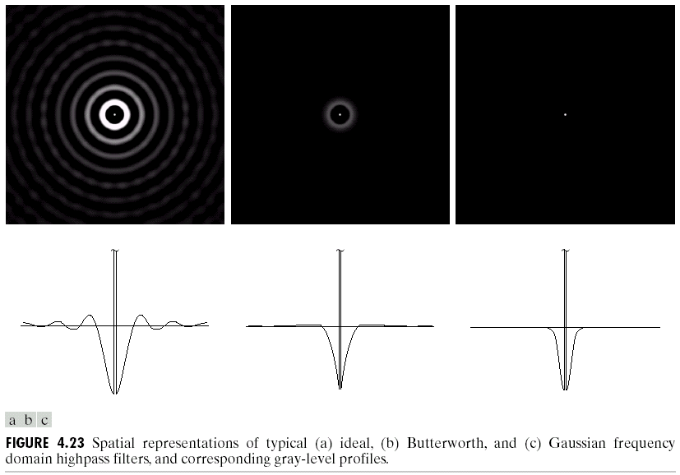
Highpass Filters
Spatial Representations

Slide 29
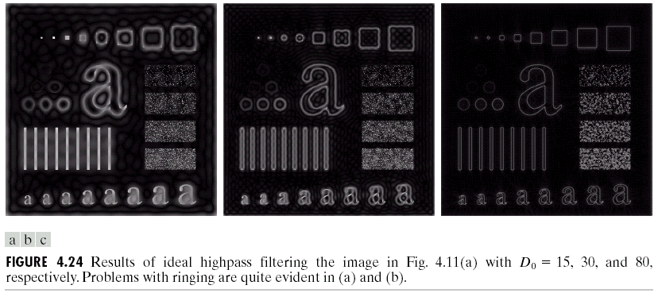
Ideal Highpass Filters

Slide 30
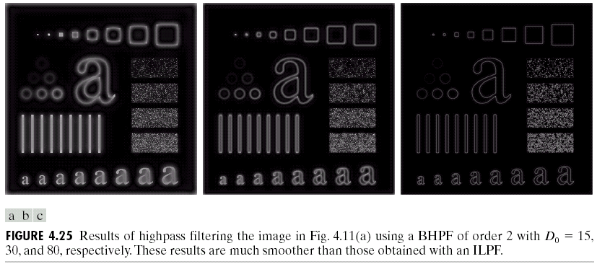
Butterworth Highpass Filters

Slide 31
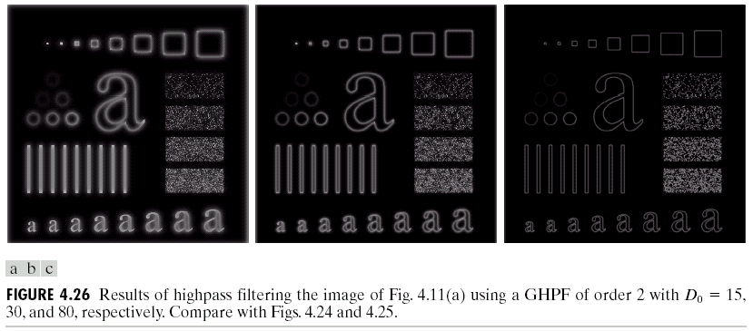
Gaussian Highpass Filters

